Slide 1
Dashboard Template Preview
Customer Analysis Dashboard
Customer Satisfaction Dashboard
Executive Dashboard
Finance Dashboard
HR Dashboard
Logistics Dashboard
Marketing Dashboard
Sales Dashboard
Social Media Dashboard
Web Analytics Dashboard

Slide 2
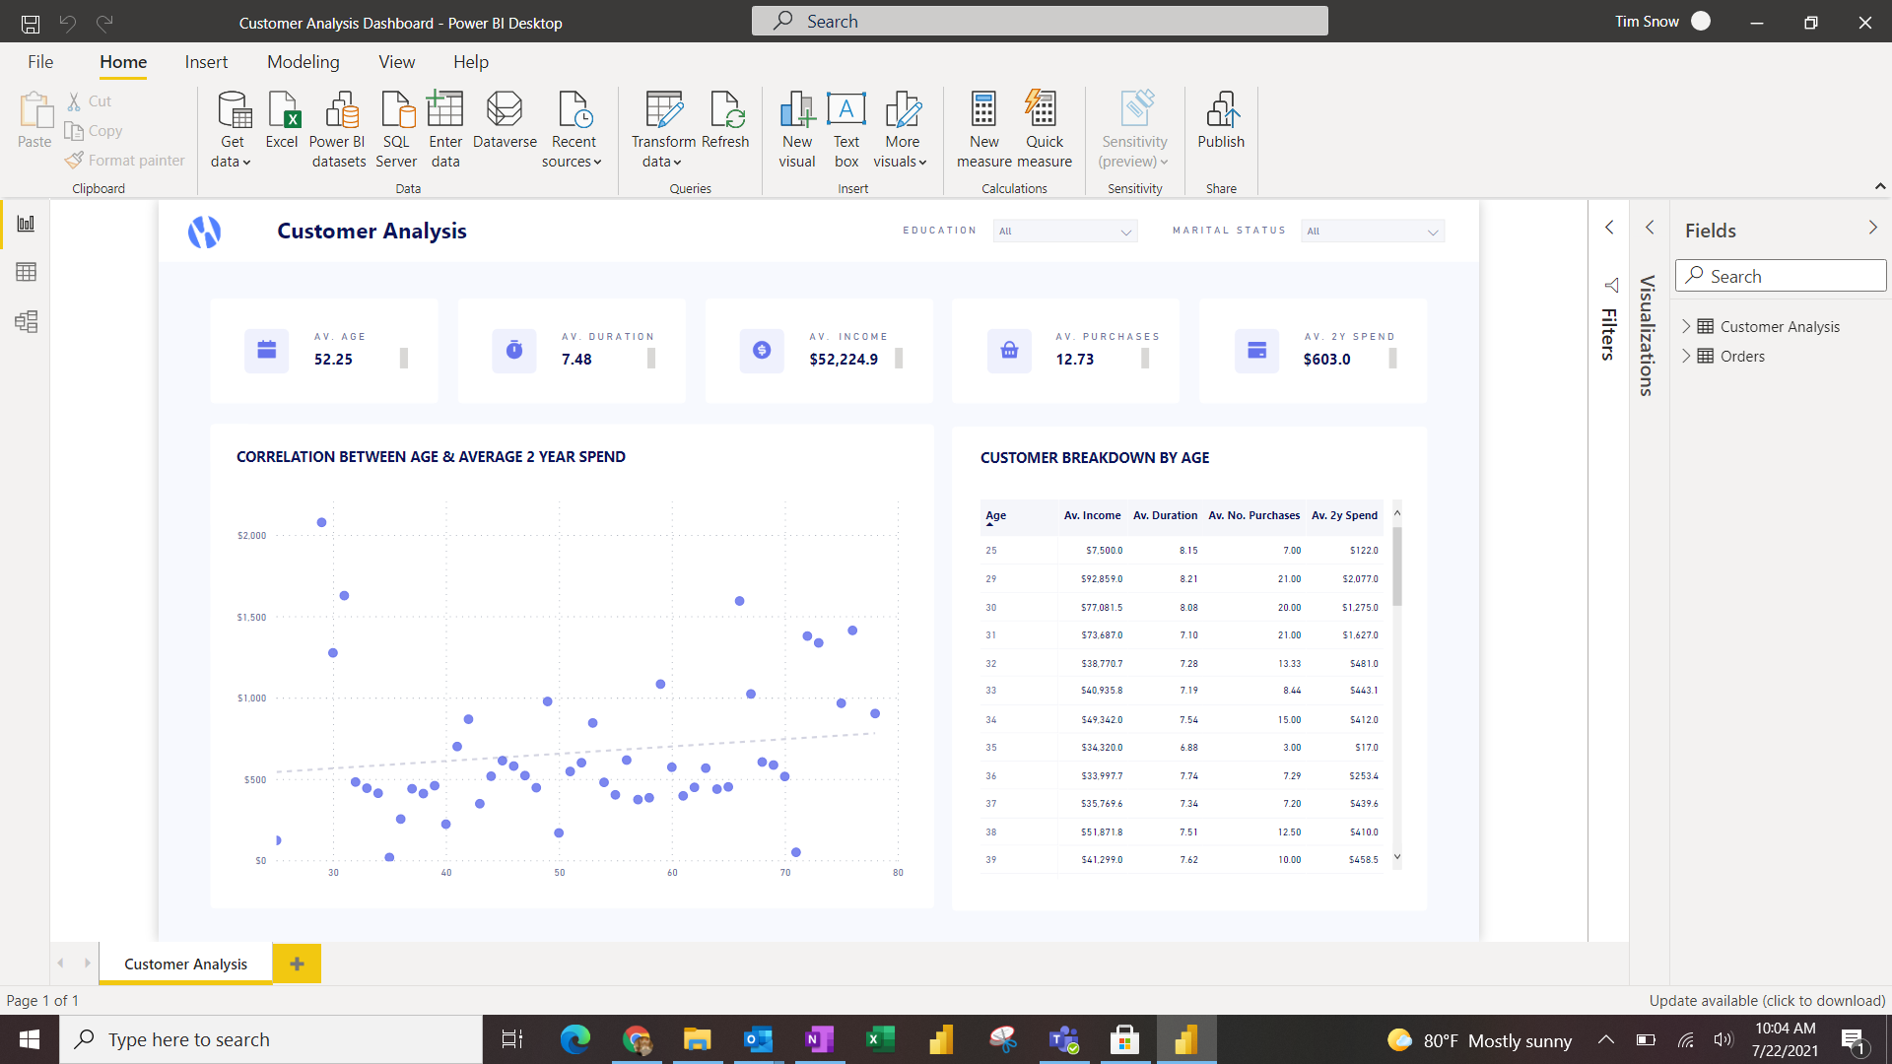

Slide 3
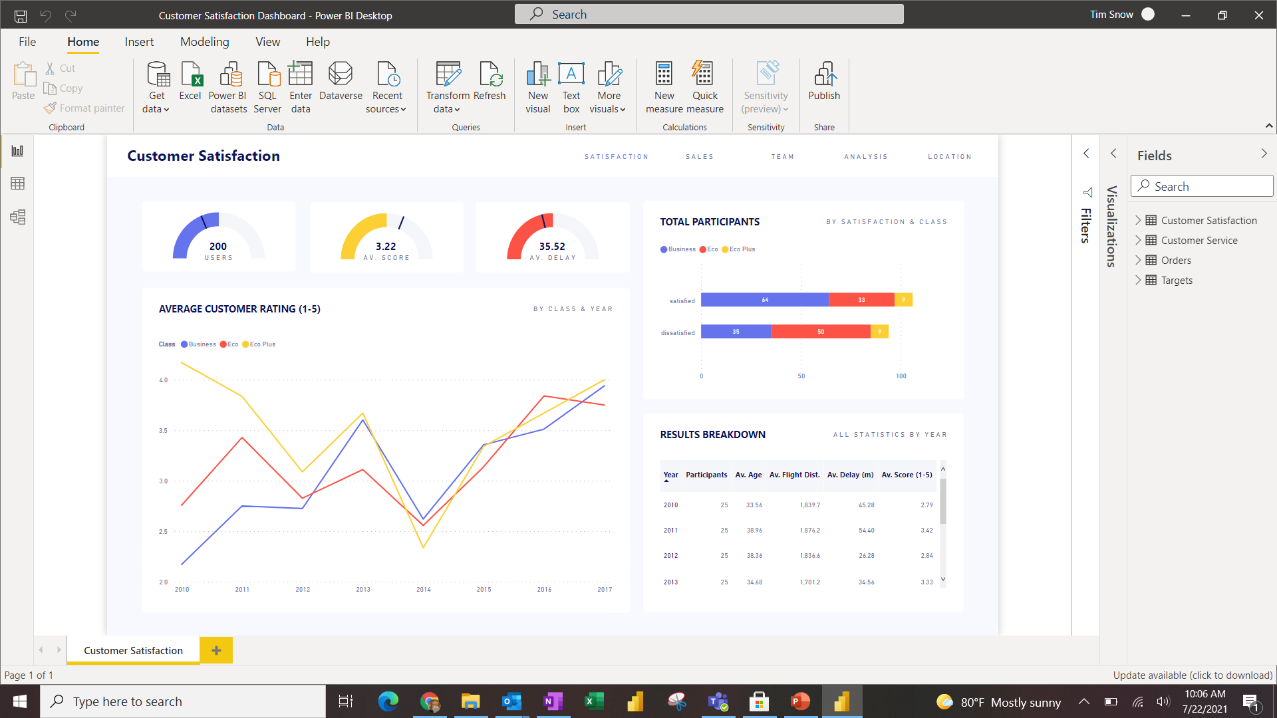

Slide 4
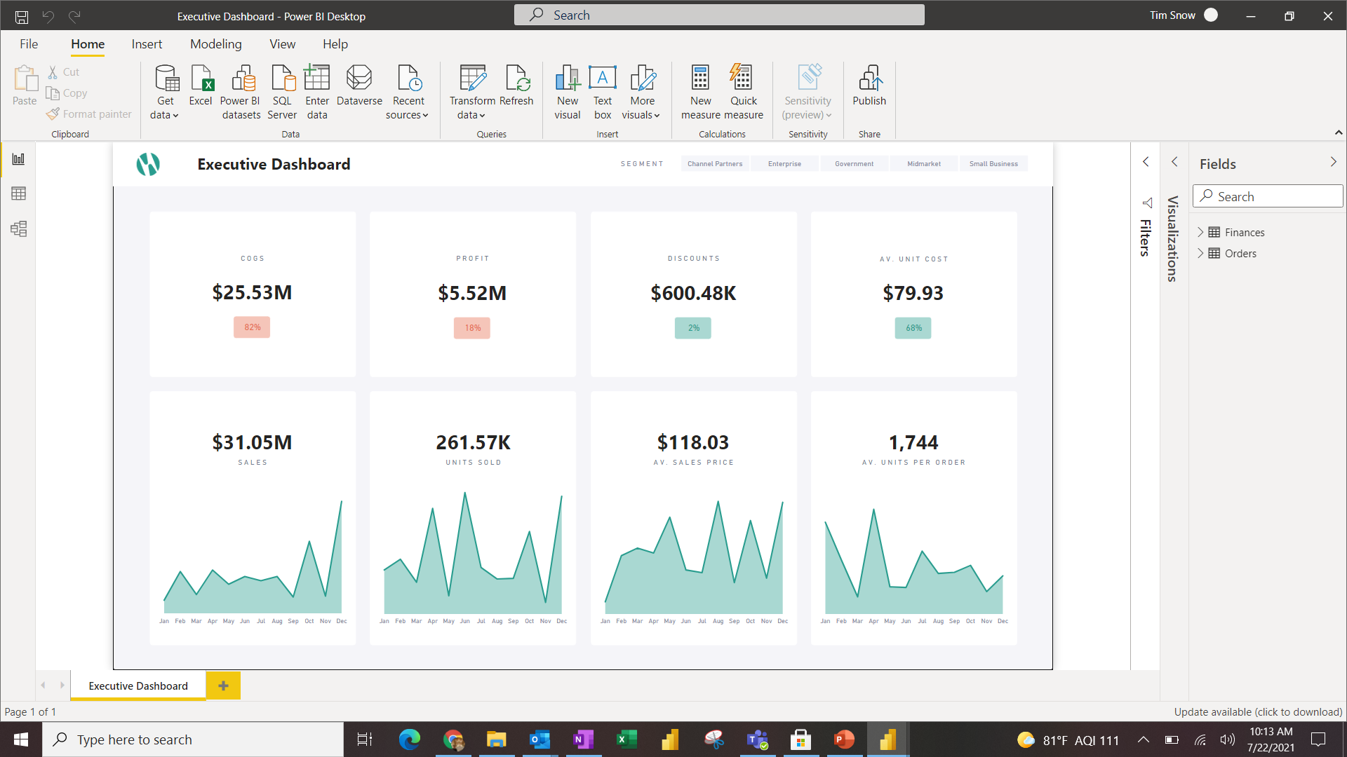

Slide 5
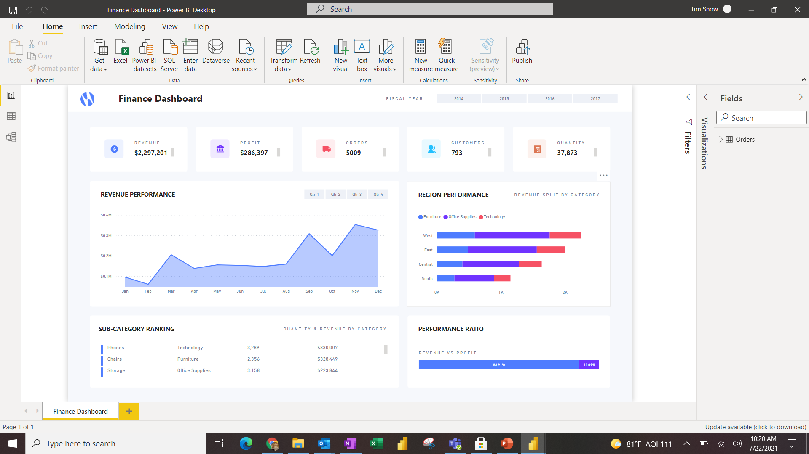

Slide 6
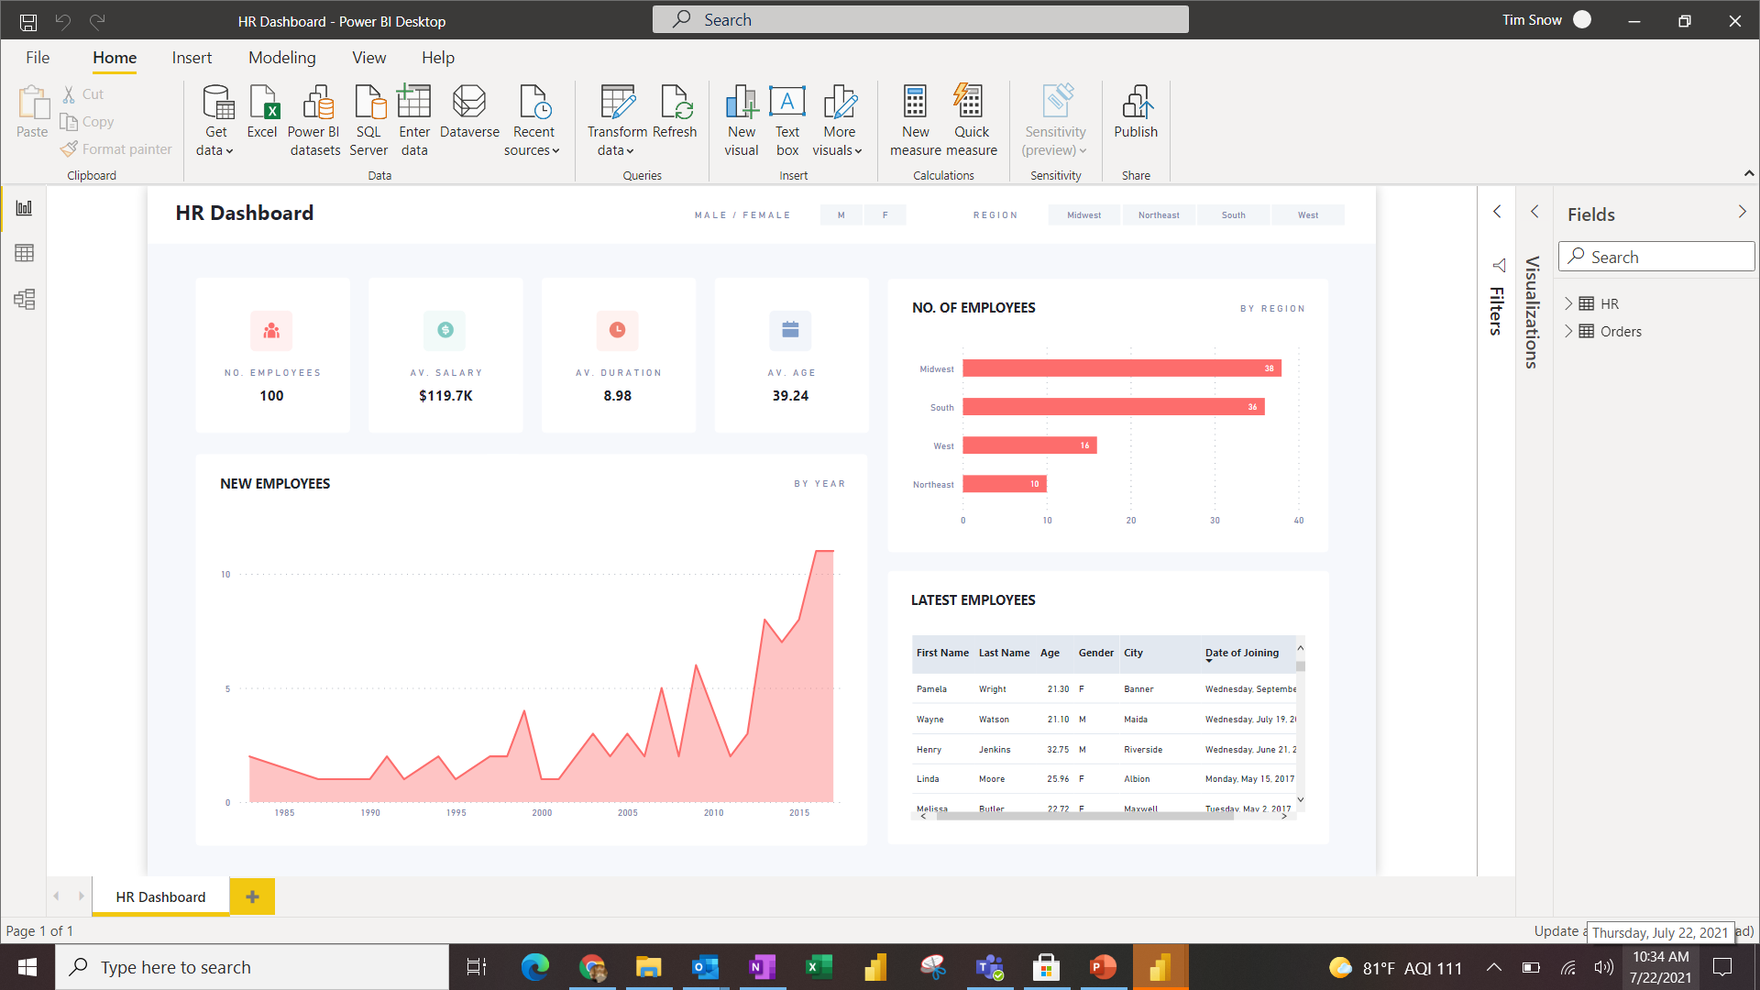

Slide 7
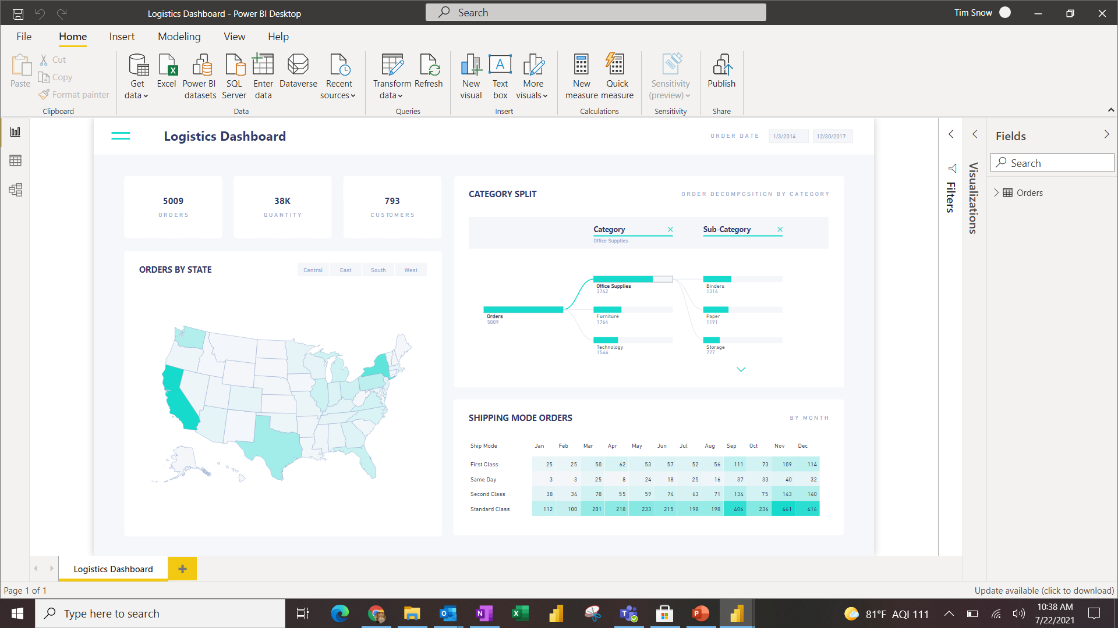

Slide 8
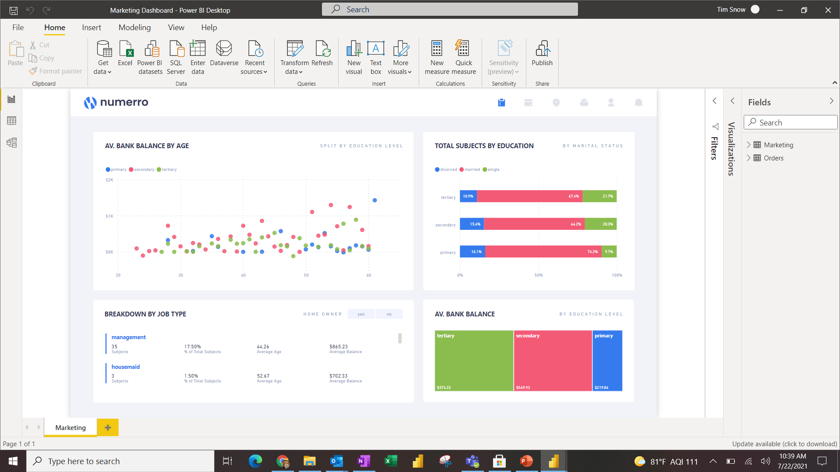

Slide 9
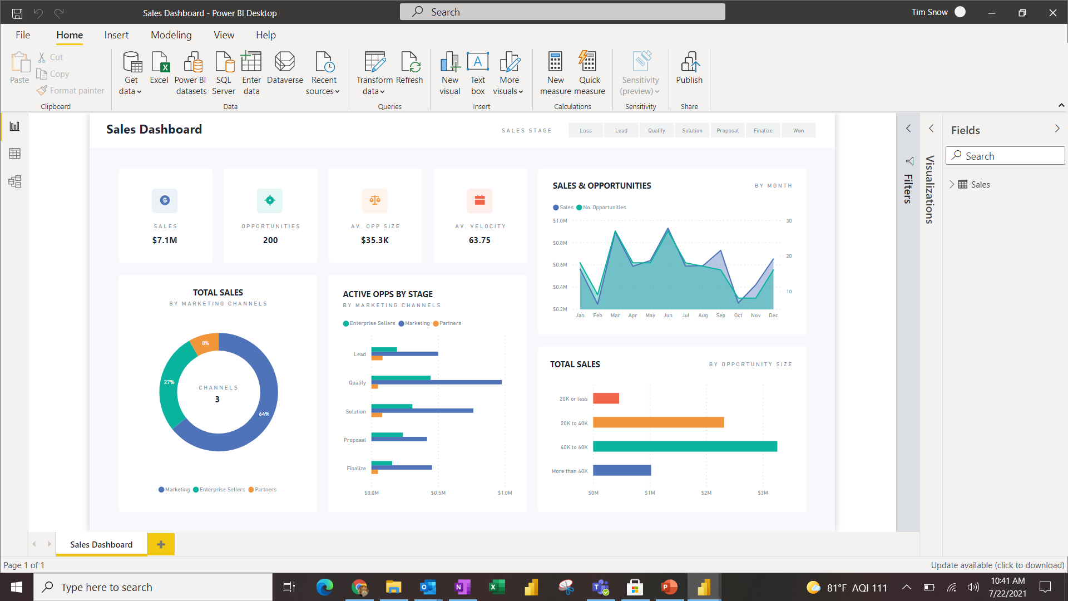

Slide 10
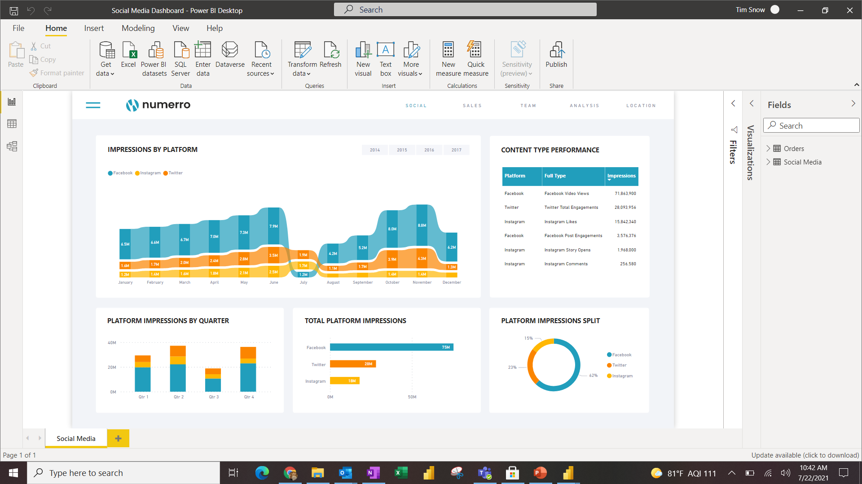

Slide 11
